Slide 1


Manual Order Processing
A guide to the Advocacy Platform’s all-in-one fulfillment manager.

Slide 2

Order processing
The importance of timely & accurate fulfillment
  Build trust: Fast, reliable fulfillment strengthens brand credibility and drives long term-loyalty.
  Drive performance: A smooth order experience increases brand engagement and advocacy.
  Financial costs: You are responsible for timely, accurate shipments and any costs resulting from reshipments and delays.
  Store shut downs: Ongoing delays or fulfillment issues will lead to program review and and risks your store being shut down.

Slide 3
Order Processing 101
Related Orders & Shipping Across Deals
Reauthorizing payment
Cancelling Orders
Returns
Issues & Support
Order Summary Email
CONTENTS

Slide 4
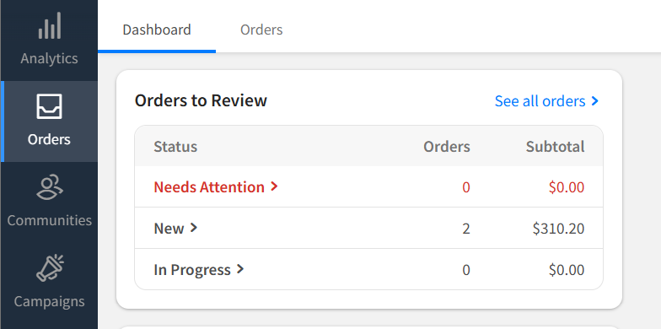
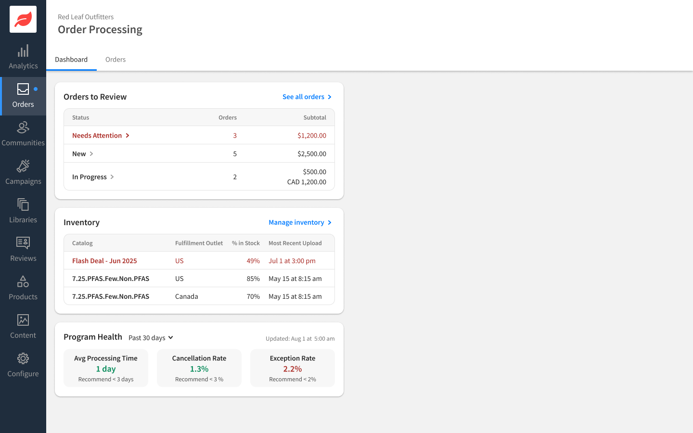
Orders dashboard
An all-in-one view of your orders and ecommerce health.
See outstanding orders by status, inventory by fulfillment outlet and program health with order metrics.

Slide 5
Orders dashboard
Needs Attention
  Late shipments
  Expired/expiring card auths
  Card declines
  Expiring orders
  Pending returns
  Escalated orders
New
  Orders ready to be processed
In Progress
  Orders ready to be shipped

Slide 6
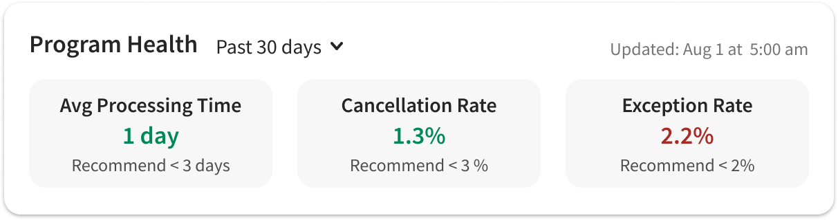
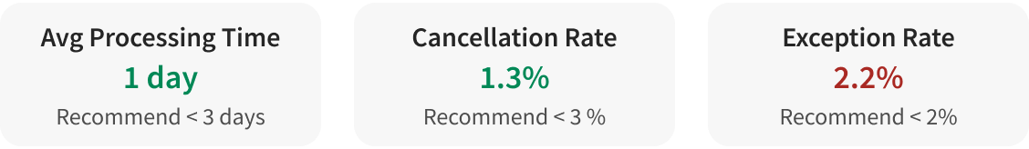
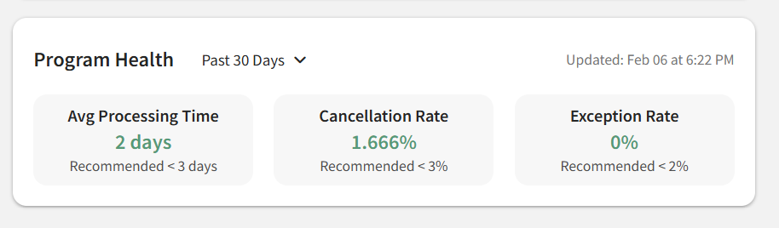
Program health
Process orders daily to maintain optimal program health.
  On the Orders Dashboard you’ll see an overview of your average 30-day fulfillment performance.
  Exception rate includes orders that have a problem, such as escalated, flagged or declined (most often a result of expired card authorizations).

Slide 7
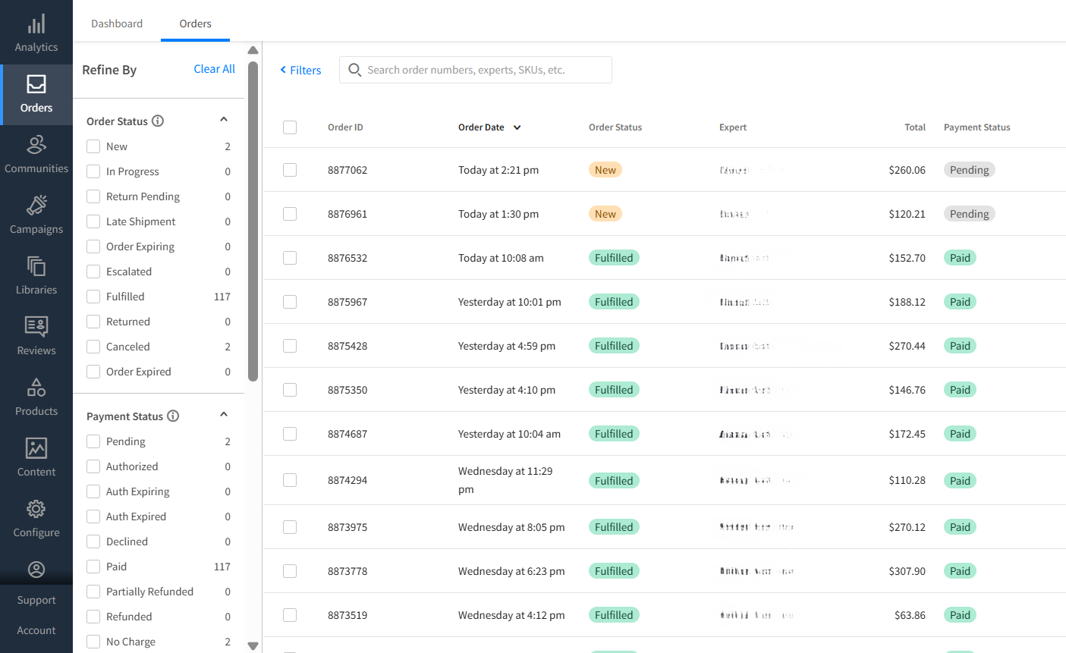

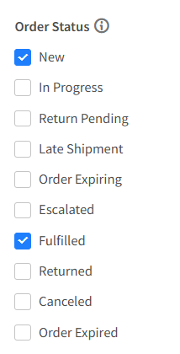
Orders list
  See all orders in one place, sorted in order of priority
  Search, sort and filter orders by status, keywords, SKU and fulfillment hub
  Select an order to start processing

Slide 8
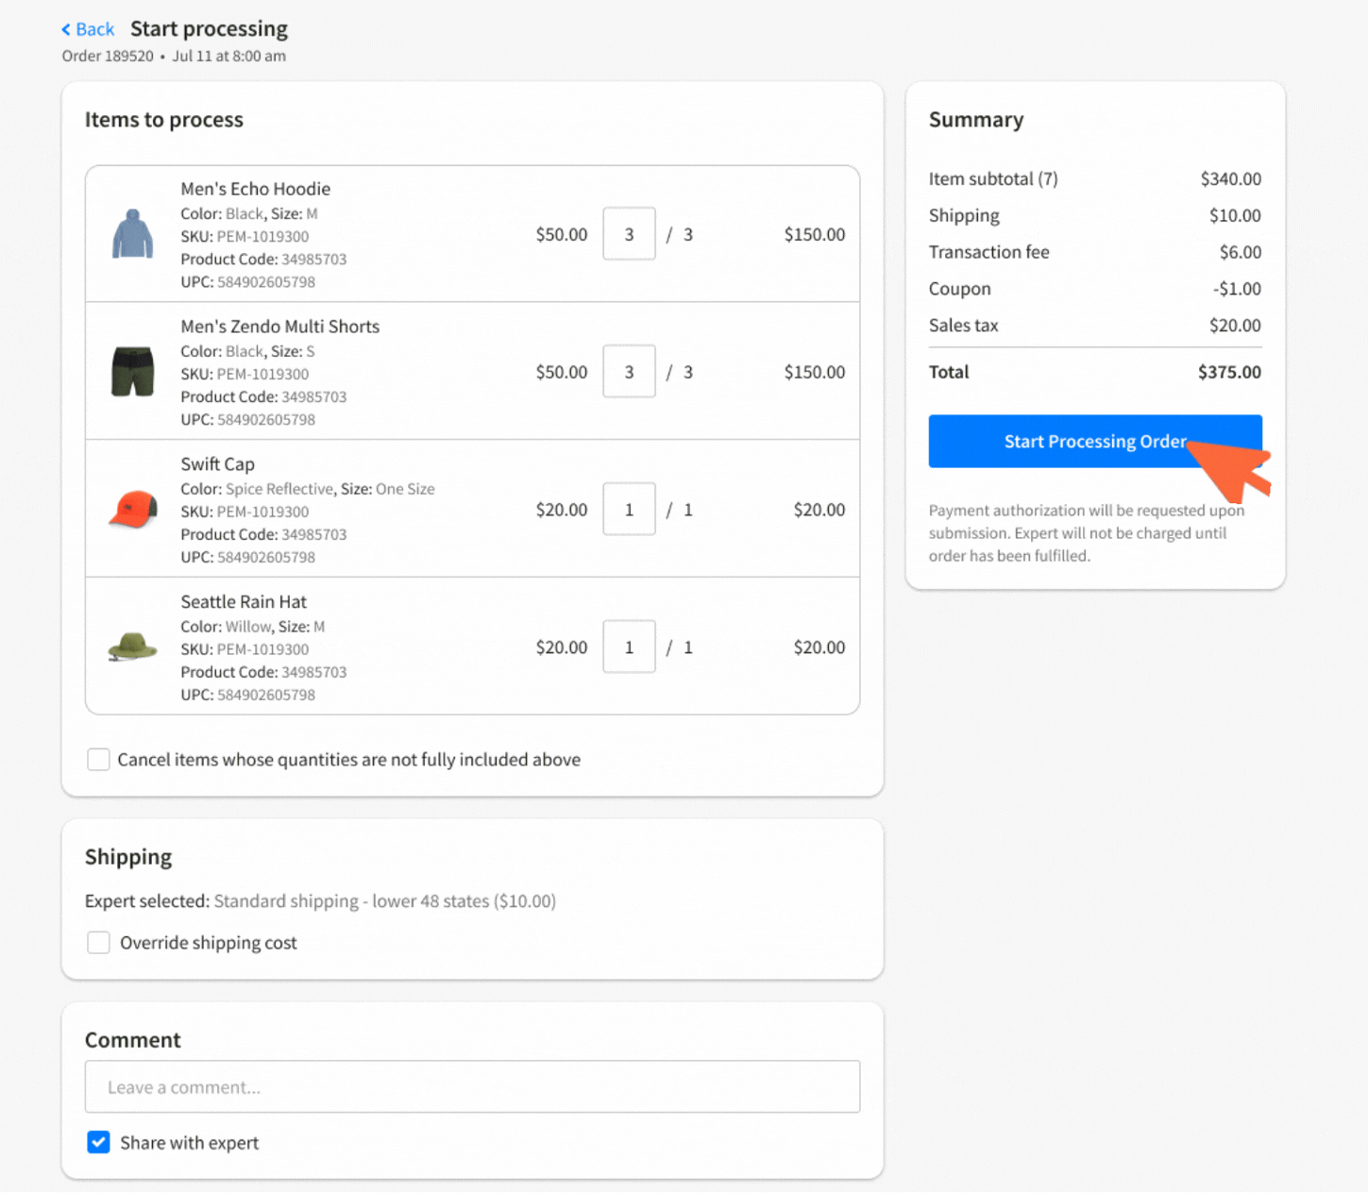
Processing orders
Review order details, adjust quantities, edit shipping or leave comments or leave comments internally or for experts.
Click Start Processing Order to initialize credit card authorization and commence the 7 day shipping window.
ⓘ Orders not shipped within the 7 days will require credit card reauthorization.

Slide 9
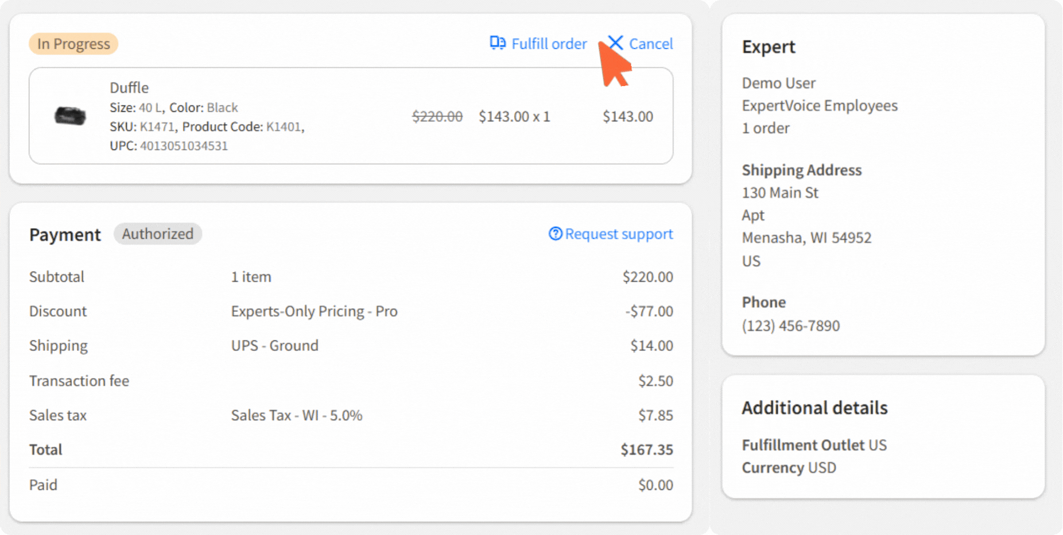
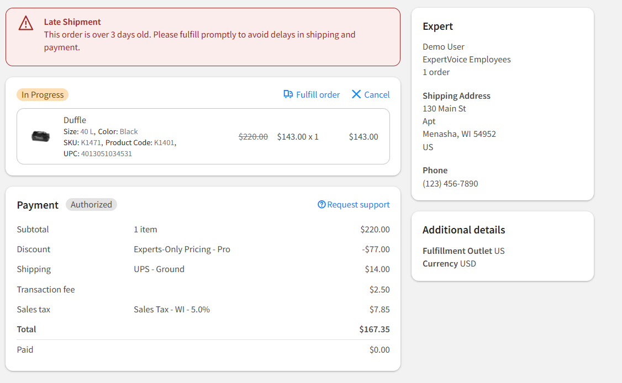
Fulfilling orders
  Once processing has started, the order status will update to In Progress.
  Select an In Progress order to view order details and retrieve shipping address.
  After you have shipped the order, click Fulfill order to add tracking info and capture payment.

Slide 10
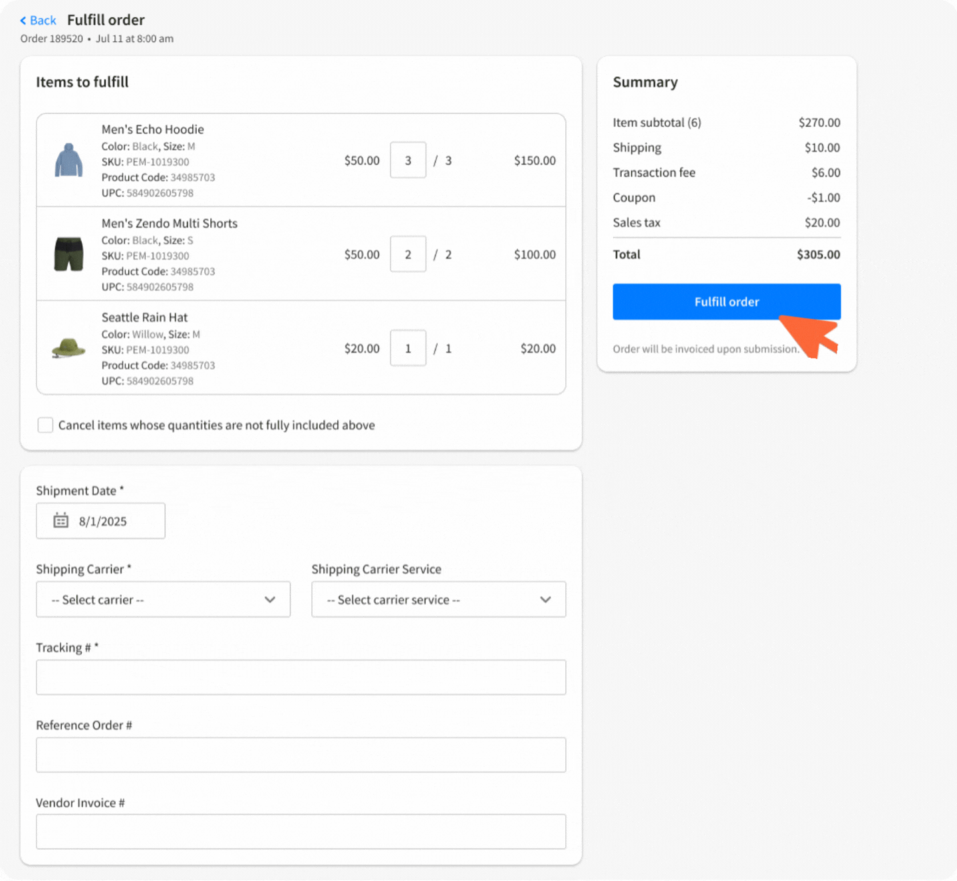
Fulfilling orders
  Review order details, adjust quantities and shipping and share order updates with experts.
  Input shipping and tracking information (required).
  Click Fulfill order button to capture payment.
★ Include Reference Order + Vendor Invoice #s from your system for clarity in financial reporting.

Slide 11
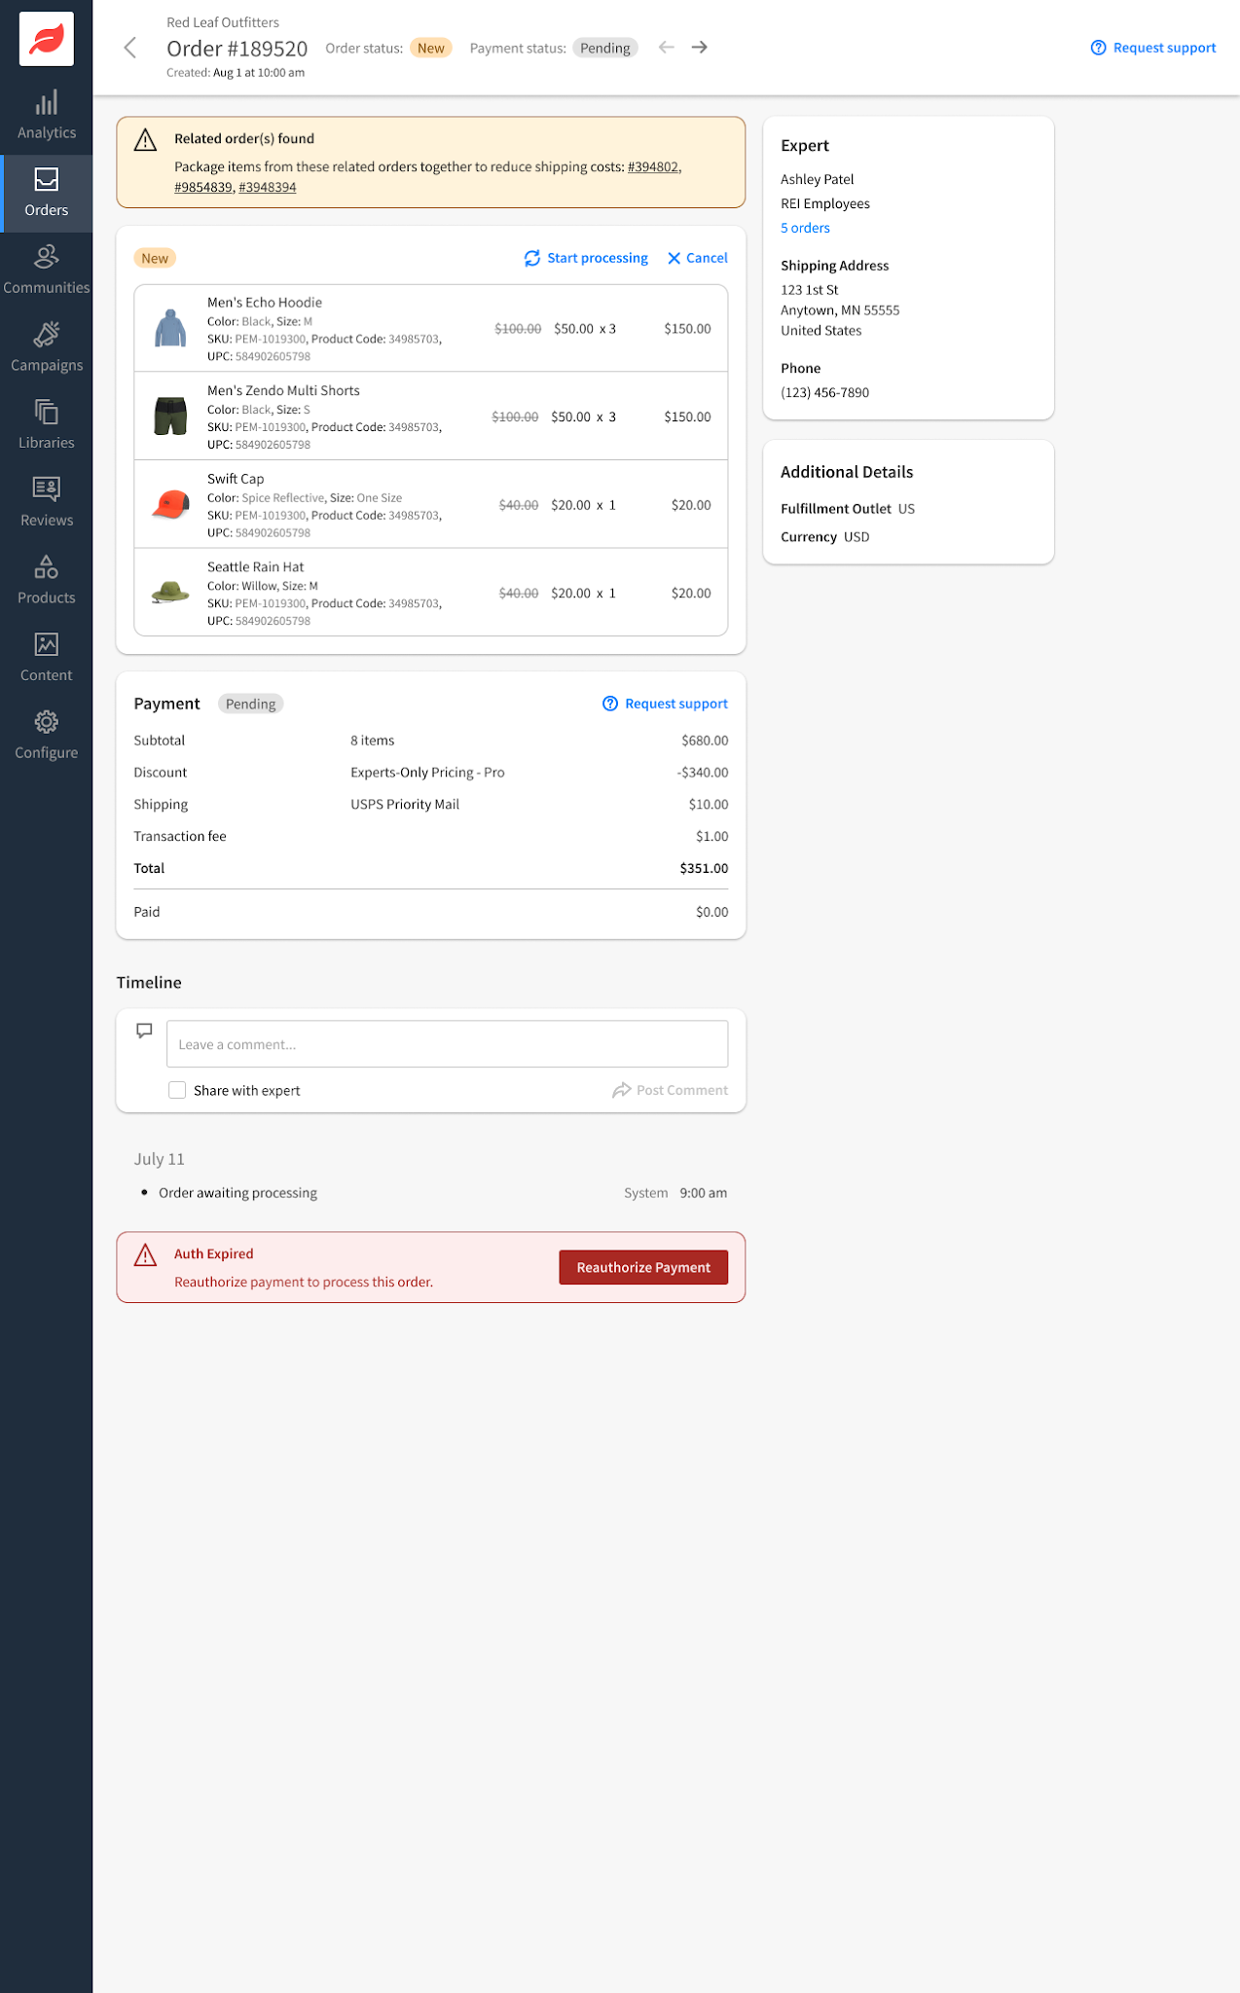
Related orders & shipping across deals
Multiple orders from the same expert should be consolidated and shipped together.
  Related orders will be flagged in the Order Detail Pages during the processing and fulfillment stages.
  Enable experts to order products from your brand’s different deals or stores, such as “Flash Deals” and “Outlet” with a single shipping fee and shipment.

Slide 12
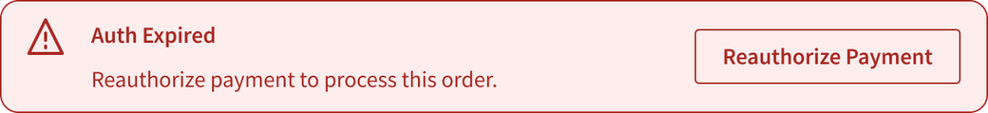
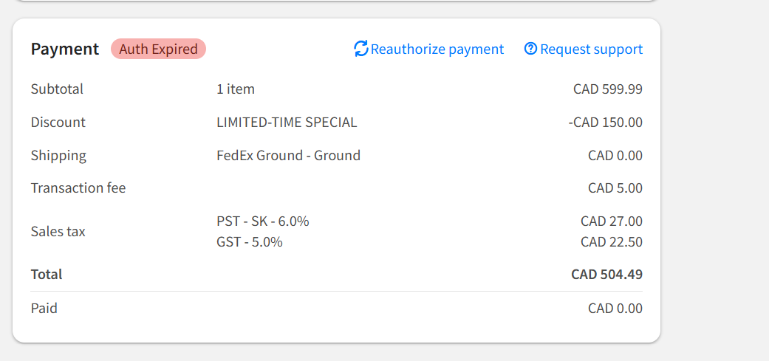
Reauthorizing payment
  Credit authorization expires if an order is not fulfilled within 7 days (168 hours) of processing.
  Expired Auths will be flagged in the dashboard, order summary email, and order details page.
  Click Reauthorize payment from the order details page to restart the 7-day authorization.
ⓘ Brands assume full responsibility for orders shipped under an expired authorization.

Slide 13
Reauthorizing payment
Important:
  Wait until the order is ready to ship.
  Double-authing can cause payment to decline and tie up funds for the expert.
  Experts can see every authorization on their end.
  If an order ships and payment is not captured, refer to the Ship No Capture Process.

Slide 14
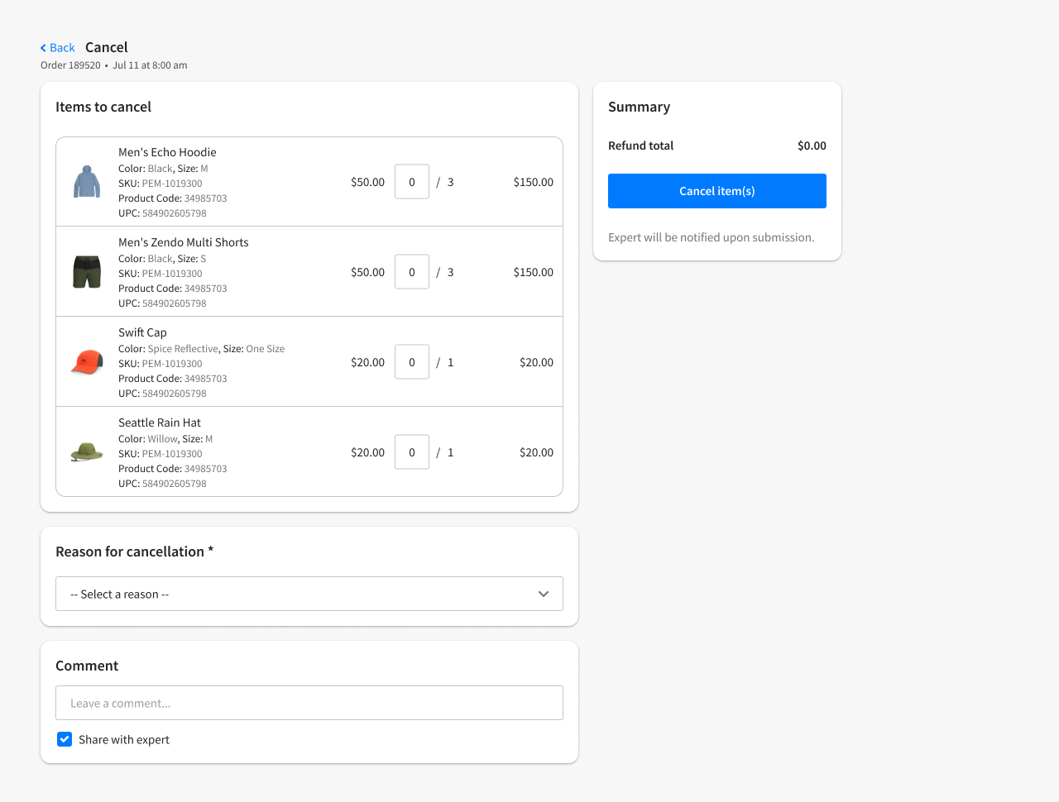

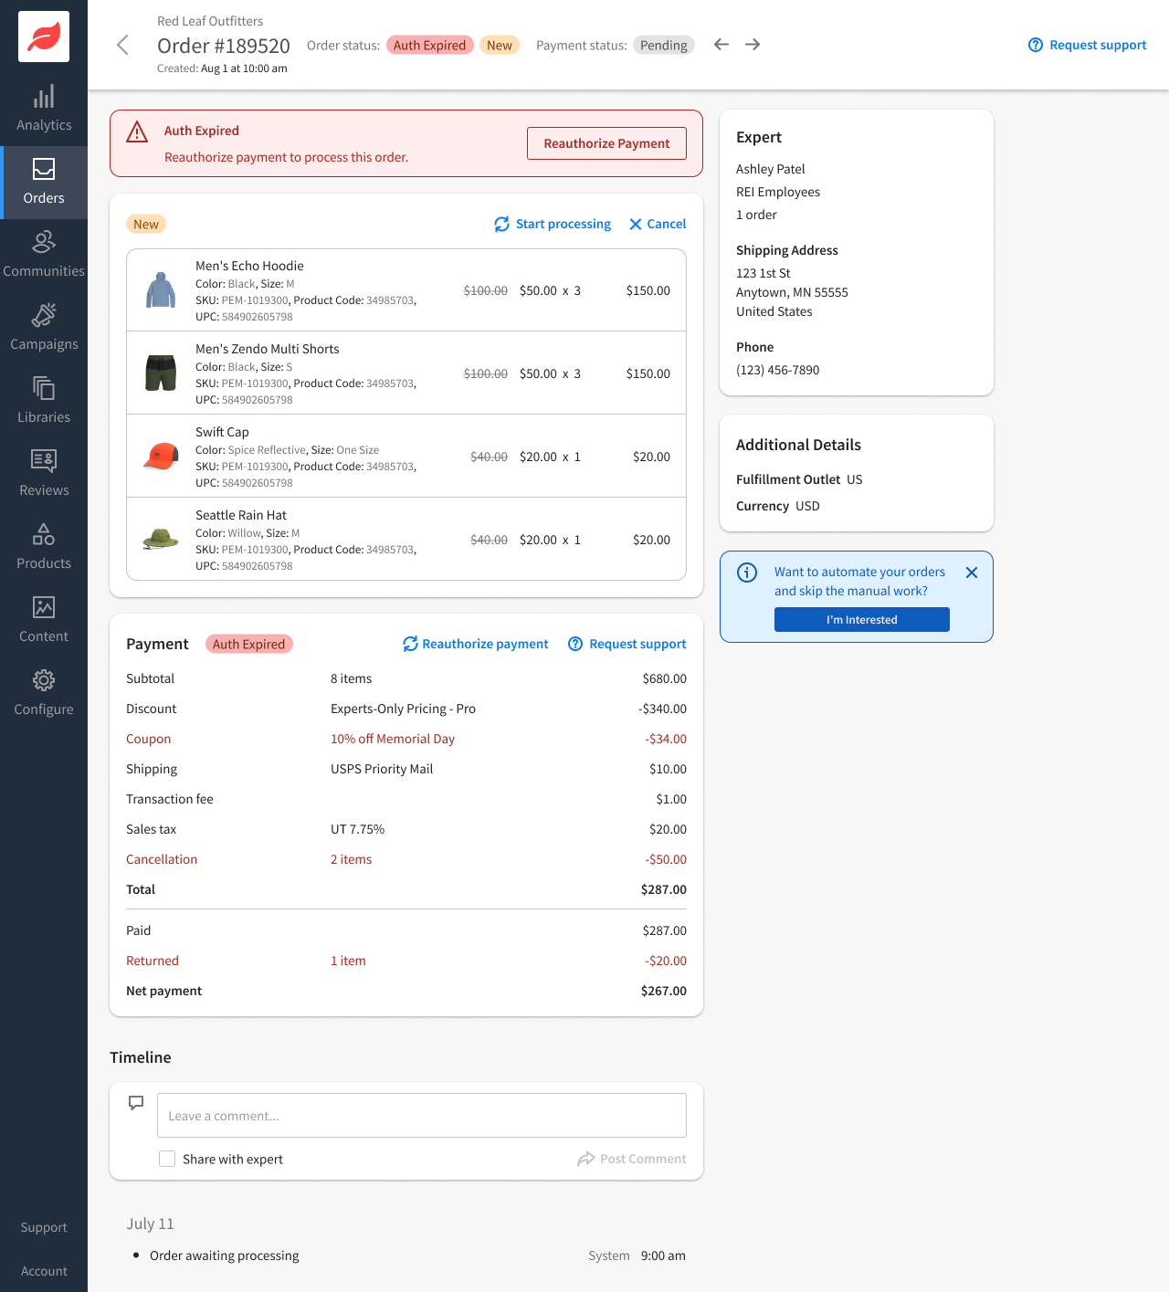
Cancelling orders
  If you're unable to fulfill an order—or an expert reaches out to cancel before fulfillment—you can cancel from the order detail page at any stage.
  Select the items and quantities that you need to cancel and a reason from the list, e.g. Out of Stock.
  Other requires that you give additional detail in the comment box

Slide 15
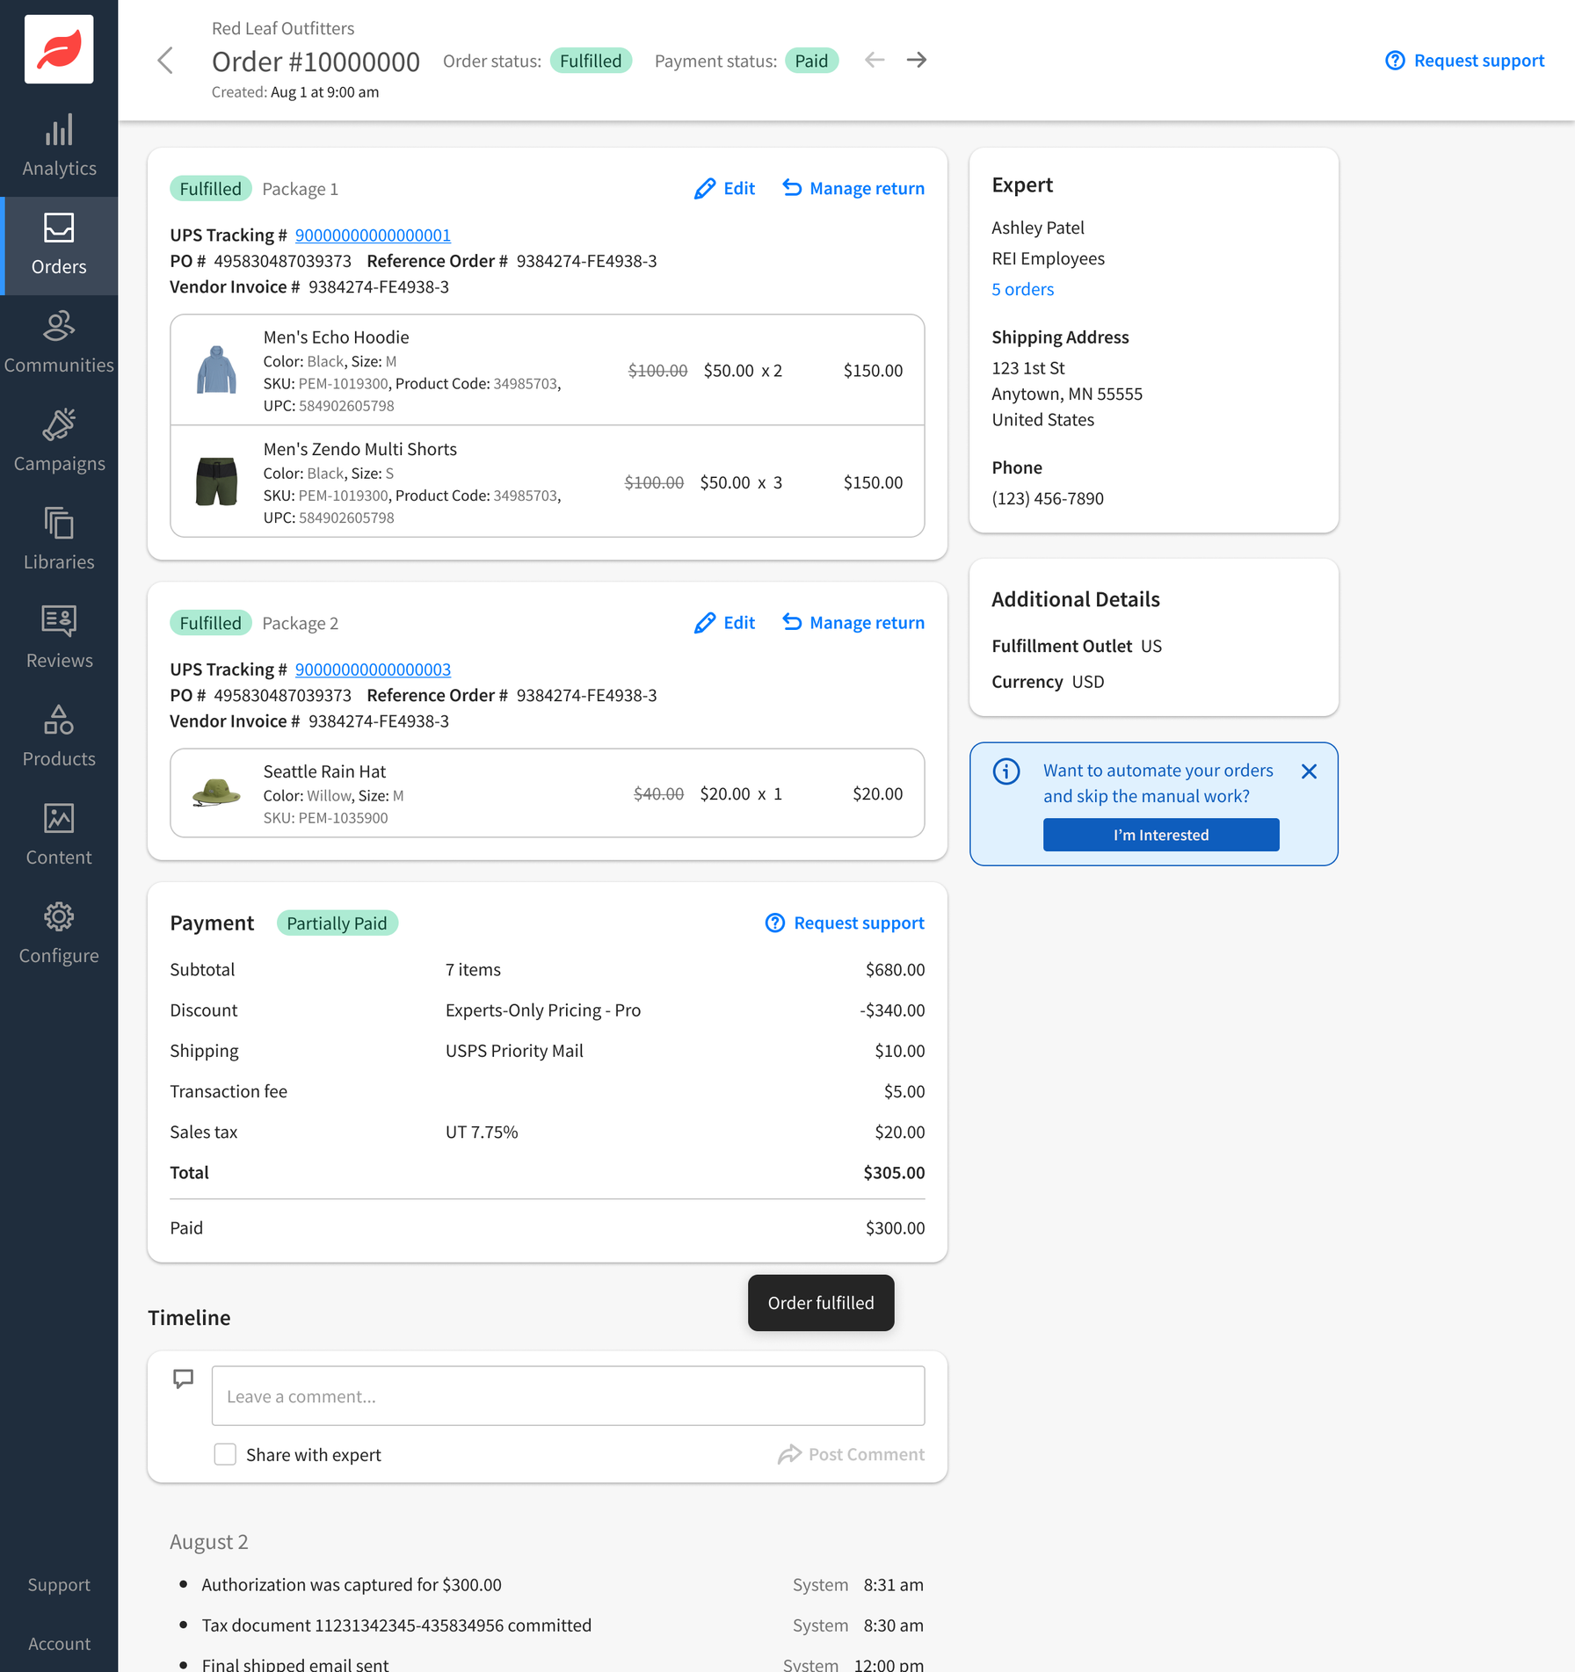
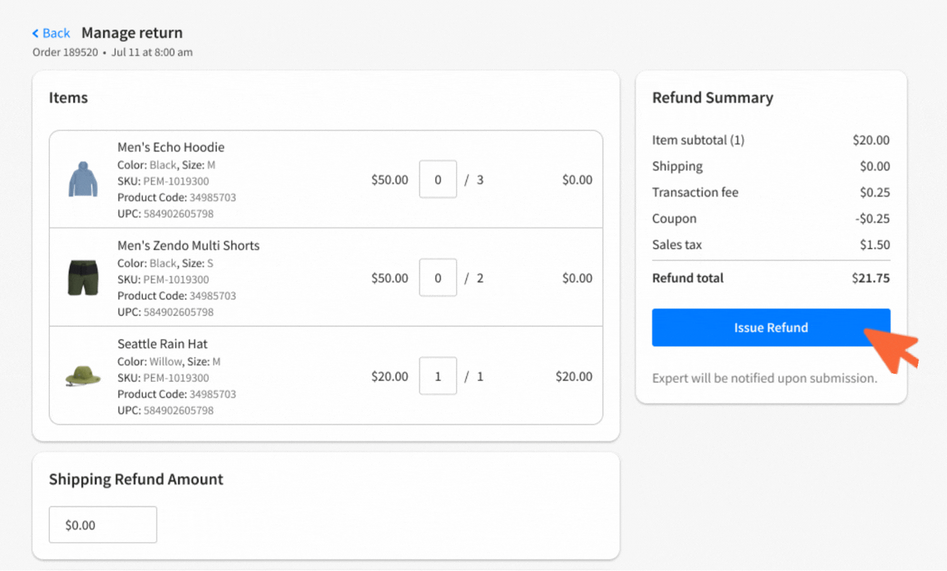
Returns
  When an expert requests a return, Expert Support will request an RMA from you via email.
  Once issued, the expert will be asked to ship the item(s) back.
  When you receive the items, click Manage return on the order detail page, select the items + quantities, then Issue refund.
  For brands using Aftership, the shipping label will trigger the refund - no need to issue manually or complete the return in our system.

Slide 16
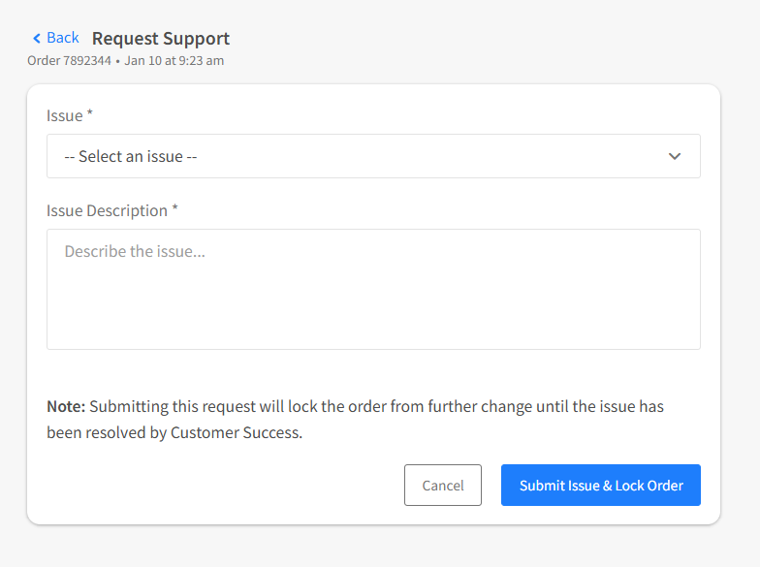
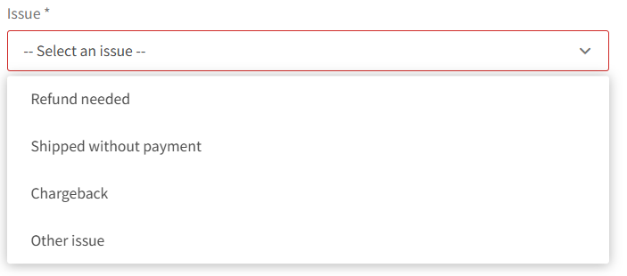
Request support
Required when:
  Refund needed
  Shipped without payment
  Chargeback
  Other issues
  Click Request Support from the order detail page and select a reason from
  the list.
  Once submitted, the order will be locked until resolved by Customer Success.

Slide 17
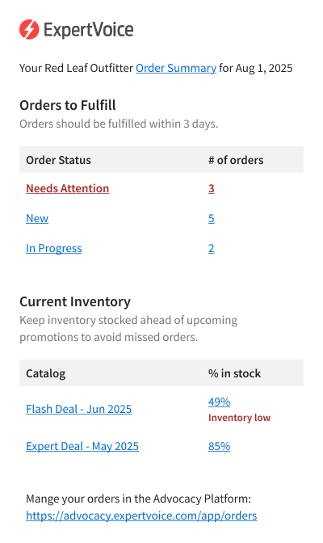
Order summary email
The order summary email gives a high-level-view of outstanding orders and inventory levels. Have your CS partner assign the appropriate team members to the order summary email list.
  Needs Attention: expiring/expired orders and authorizations, declines, late shipments, pending returns, escalated orders
  New: yet to be processed
  In Progress: waiting to be shipped
Remember to check your spam folder if you are not seeing the emails.
Notes:
Late shipments
Expired/expiring card auths
Card declines
Expiring orders
Pending returns
Escalated orders

Slide 18
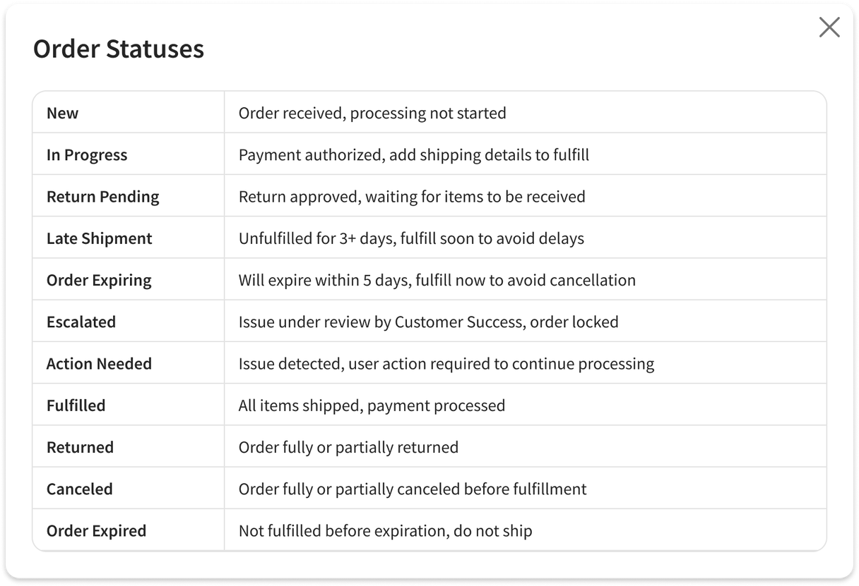
Order statuses
  Order statuses are displayed in the dashboard, order summary email, orders list page and order detail pages.
  They use a traffic light color system to help you quickly identify and prioritize orders that are new or in need of attention.

Slide 19
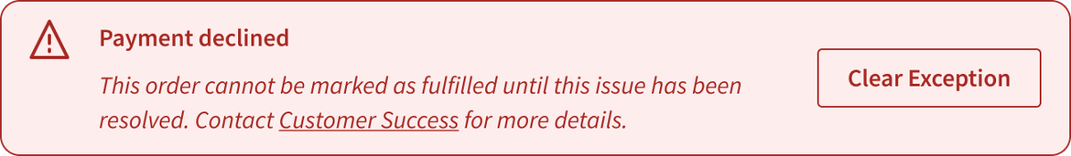
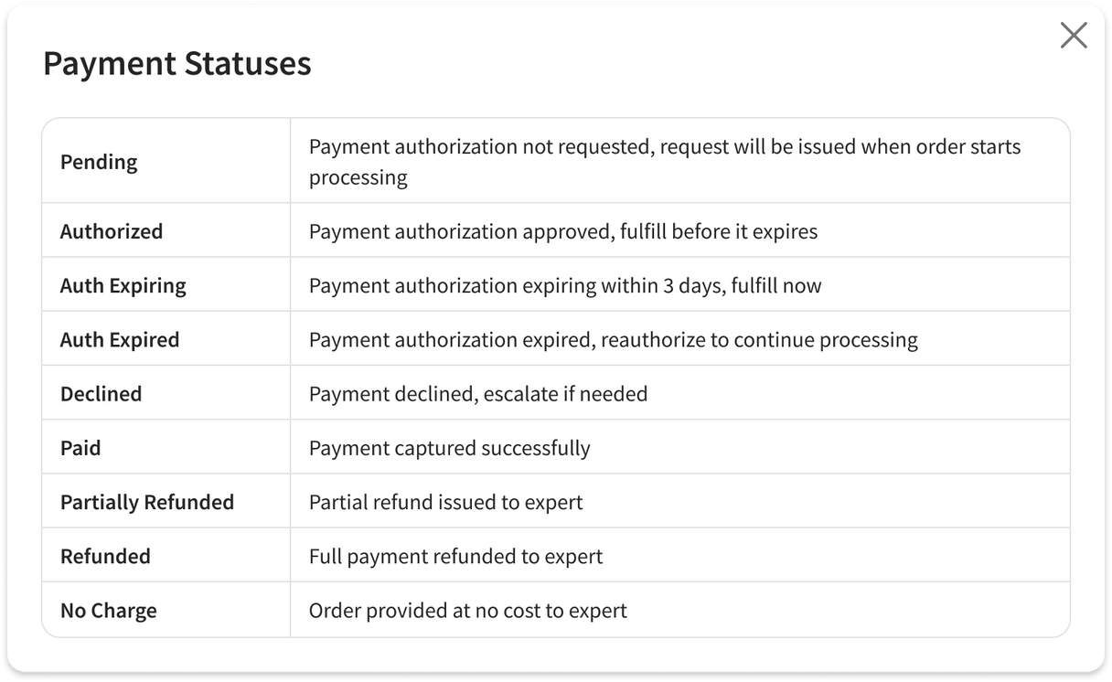
Payment statuses
  Payment statuses are displayed in the orders list page where they can be used as a filter and the order detail pages.
  They use a traffic light color system to help you quickly identify and address orders in need of attention.

